Slide 1

Human Activity Recognition Classification Using Python
Hala Waseem Aye

Slide 2
Outline
Introduction
Background
Methodology
Results
Conclusion

Slide 3
1) Data
Introduction
Smartphones are the most useful tools in our daily lives. It collects a huge amount of data that can be transformed into useful information and knowledge in order to fulfill consumers needs and demands.
One of the data Smartphones collect is sensor movement data. It has become a very active area of research to classify different users' activities for many reasons.
Classifying users’ activities can be used in health monitoring applications, seniors tracking applications, and even kids.
For example, patients of diabetes, obesity, or heart diseases are required to follow a specific exercise routine that needs to be monitored and tracked.

Slide 4
1) Data
Background
Classification of human activities has been the main focus in different studies using different machine learning algorithms.
In [1] a data set consists of signals from accelerometer and gyroscope of a smartphone while doing different activities are classified using Decision Trees, Support Vector Machine and K-nearest neighbors (KNN).
In [2] they declared k- nearest neighbors (KNN) as the best classifier, but still failed to effectively classify very similar activities.

Slide 5
1) Data
Background Cont.
Another research has found that the placement of the device affects the accuracy of measured activity; placing the device on the thigh is the most accurate for classifying activities.
In [3] they discussed Human activity recognition with smartphone sensors using deep learning neural networks using greedy-wise tuning of hyper-parameters and, achieved the best performance of approximately 97% with 3 dense layers.
In [4] they studied the Correlation Analysis-Based Classification of Human Activity Time Series using both Principal Component Analysis and Canonical Correspondence analysis (CCA), to cluster together consecutive data points that belong to the same event. Achieving the accuracy result of 98.8% for PCA and 76.7 % for CCA.

Slide 6
Methodology
Data
Preprocessing and Exploratory Data Analysis
Feature selection and Principal component analysis (PCA)
Classifiers selection and model building

Slide 7
1) Data
1) Data
We used the Kaggle Human Activity Recognition data set, with a small modification from our instructors. [5]
The Human Activity Recognition data set was built from the recordings of 30 study participants performing activities of daily living, while carrying a waist-mounted smartphone with embedded inertial sensors.
The objective is to classify activities into one of the six activities performed
It consisted of 591 features, 9990 rows and a class feature.
Walking | Walking Upstairs | Laying
Sitting | Walking Downstairs | Standing

Slide 8

2) Preprocessing and Exploratory Data Analysis
2.1) Concatenating Test and Train Data sets
We started by excluding the class feature and concatenating the train and test data sets so we can do all preprocessing steps on the whole data.
2.2) Check NA values
After checking the data as shown in Figure 1. It turned out that we have 40000 null values located in 30 features as shown in figure 1. We decided to drop those features because, it will not affect the classifiers as a matter of fact it will produce noise and consume unnecessary resources.
Figure 1

Slide 9
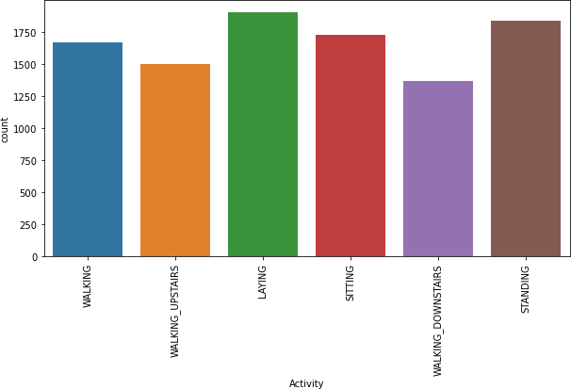
2) Preprocessing and Exploratory Data Analysis Cont.
2.3) Check Class Balance
After excluding the nulls from our data, we calculated the number of instances per class to check the number of instances for every class, as shown in Figure 2. Classes were unbalanced with a slight difference; such difference will not affect the performance of the classifiers.
Figure 2

Slide 10
3) Feature Selection and Principal Component Analysis (PCA)
Principal Component Analysis (PCA) is an unsupervised, non-parametric statistical technique primarily used for dimensionality reduction in machine learning.
High dimensionality means that the data set has a large number of features.
To reduce dimensionality therefor, reduce computational power and, avoid over-fitting PCA was used.

Slide 11
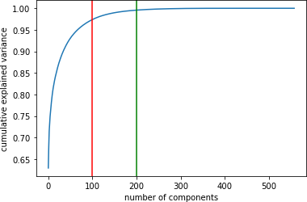
3) Feature Selection and Principal Component Analysis (PCA) Cont.
This curve in Figure 3 quantifies how much of the total, 591-dimensional variance is contained within the first N components. We see that with the digits, 200 components contain approximately 100% of the data variance. So, we choose 200 features instead of 591 to represent our data.
Figure 3

Slide 12
4) Classifiers Selection and Model Building
Random Forest Classifier
Light Gradient Boosting Machine Classifier
K-Nearest Neighbors Classifier
Logistic Regression
Support Vector Classifier

Slide 13
Results
Classifier | Accuracy
Logistic Regression Classifier | 98.08
Support Vector Classifier | 97.69
LGBM Classifier | 96.48
K Nearest Neighbors Classifier | 95.99
Random Forest Classifier | 92.35

Slide 14
Conclusion
Conclusion
This research was aimed to extract knowledge from human activities recognition data set, to identify different users activity from the information gathered by the different sensors.
Unsimilar to previous results conducted from previous research we deduced different results.
K-Nearest Neighbors and Light Gradient Boosting Machine Classifier (LGBM) did not score the best accuracy results.
In fact, Logistic Regression Classifier got the highest accuracy of 98.08%. The closest accuracy score to Logistic Regression was Support Vector Classifier 97.69%. K-Nearest Neighbors and Light Gradient Boosting Machine Classifier (LGBM) scored approximately the same with a slight difference the score of 96%.

Slide 15
Questions?

Slide 16
References
References
[1] Erhan Bulbul, Aydin Cetin, and Ibrahim Alper Dogru. Human activity recognition using smart- phones. In 2018 2nd international symposium on multidisciplinary studies and innovative technologies (ismsit), pages 1–6. IEEE, 2018.
[2] Wanmin Wu, Sanjoy Dasgupta, Ernesto E Ramirez, Carlyn Peterson, and Gregory J Norman. Classification accuracies of physical activities using smartphone motion sensors. Journal of medical Internet research, 14(5):e130, 2012.
[3] Charissa Ann Ronao and Sung-Bae Cho. Human activity recognition with smartphone sensors using deep learning neural networks. Expert systems with applications, 59:235–244, 2016.
[4] Akshay Malhotra, Ioannis D Schizas, and Vangelis Metsis. Correlation analysis-based classi- fication of human activity time series. IEEE Sensors Journal, 18(19):8085–8095, 2018.
[5] Kaggle Human activity recognition https://www.kaggle.com/uciml/human-activity-recognition-with-smartphones.

Slide 17
Thank you! Hala Aye

